Slide 1
Generating 3D Shoe models
from a single side view
Nasir Khalid
COMP 6381 - Digital Geometric Modeling
Fall 2021

Slide 2
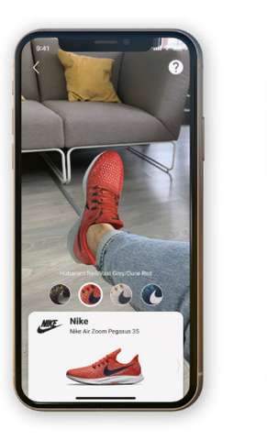
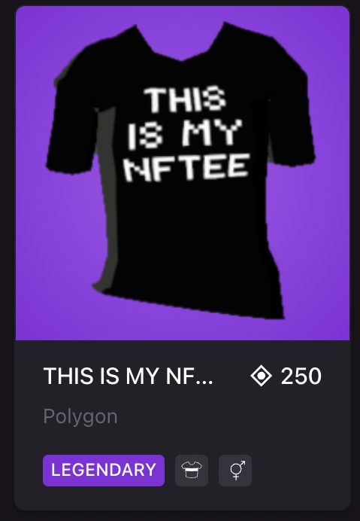
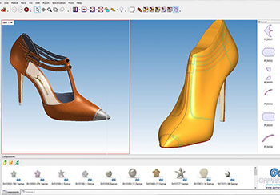
Applications
Reduce time + cost of 3D asset generation
Allow for user customizability
Easier than prototyping

Slide 3
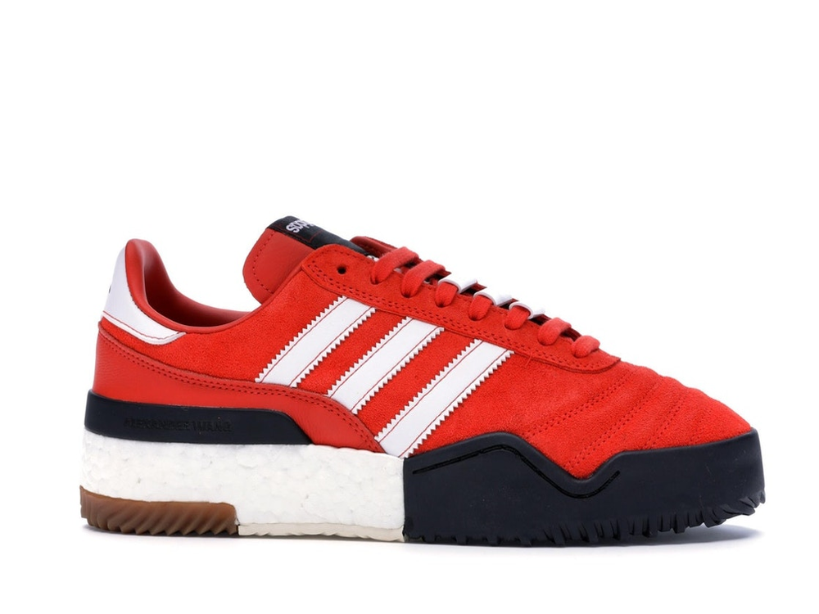
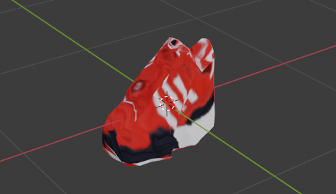
Objective
Criteria for method
Input must be single image
Run as fast as possible
Generalize for new shoe
No 3D data needed at any point
2D Image
3D Model

Slide 4
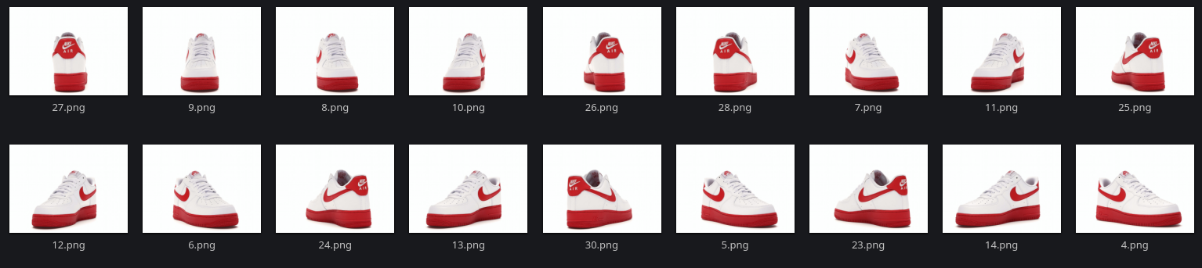
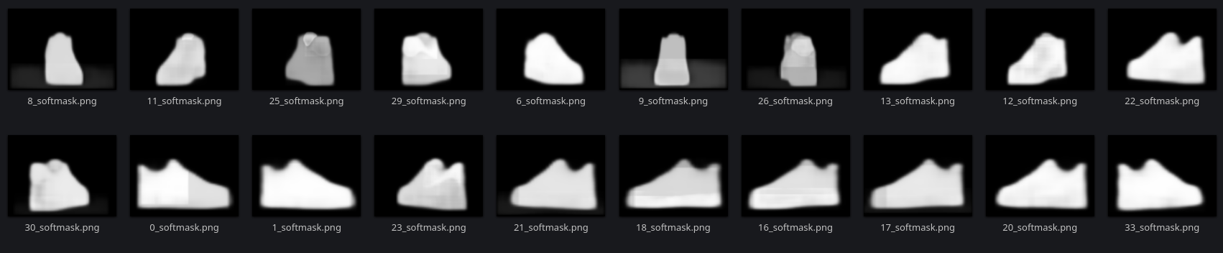
Data
360 degree images of shoes ~ 7500 shoes
Masks created using segmentation network

Slide 5
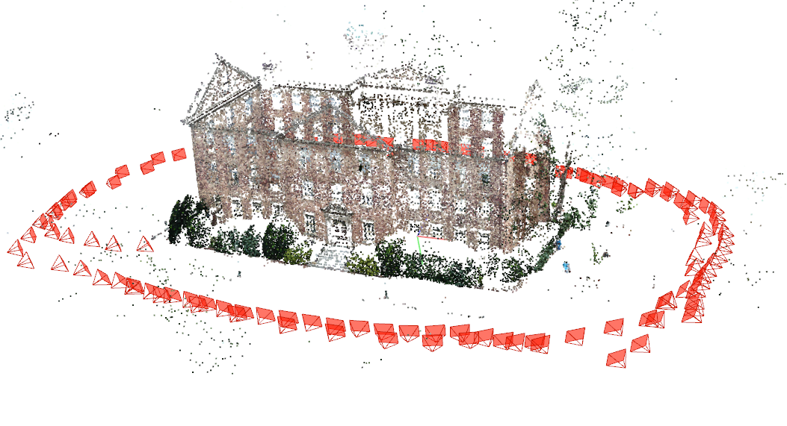
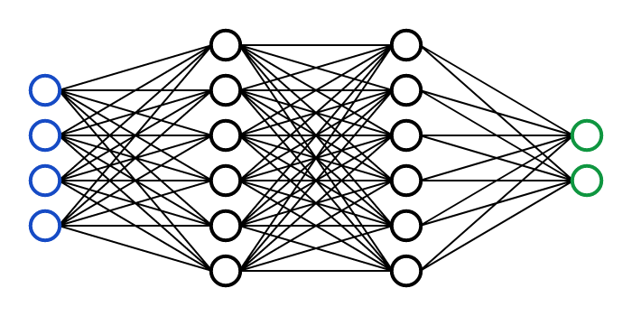
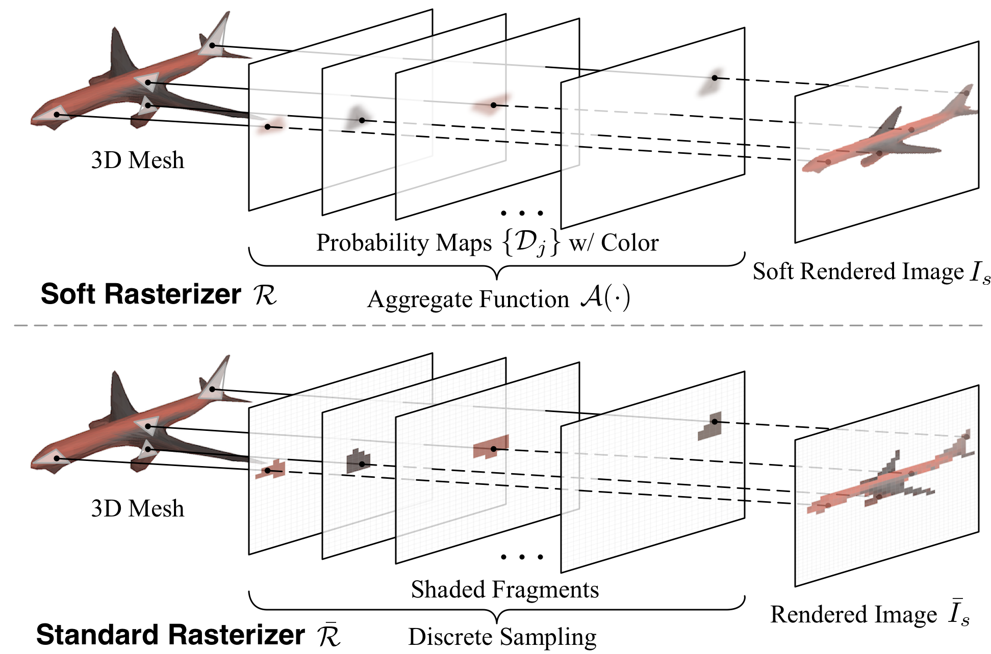
Methods
COLMAP
Input Single Image
Fast
Generalize
No 3D training data
Neural Network
Input Single Image
Fast
Generalize
No 3D data
Optimize with Differentiable Renderer
Input Single Image
Fast
Generalize
No 3D data

Slide 6
Methods
NOT Differentiable
(out of the box)
Differentiable
Differentiable
COLMAP
Input Single Image
Fast
Generalize
No 3D training data
Neural Network
Input Single Image
Fast
Generalize
No 3D data
Optimize with Differentiable Renderer
Input Single Image
Fast
Generalize
No 3D data

Slide 7
Methods
Can combine both methods and meet all criteria
Differentiable
Differentiable
Neural Network
Input Single Image
Fast
Generalize
No 3D data
Optimize with Differentiable Renderer
Input Single Image
Fast
Generalize
No 3D data

Slide 8
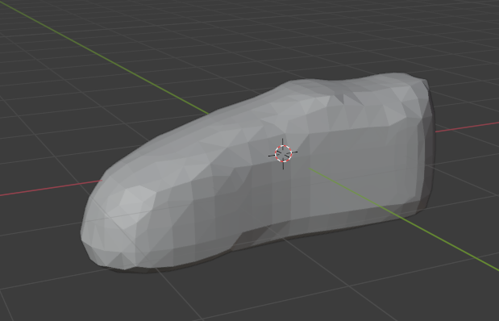
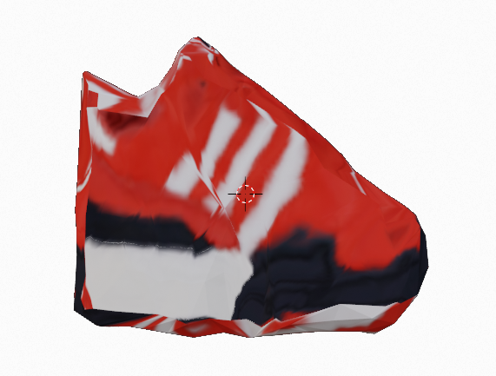
Approach
Train a network that can deform + texture a base shape through differential renderer
Differentiable
Renderer
Network
Image loss

Slide 9

Approach - Architecture
Flow Map
UV Texture Map
UNet
Mesh
Shape Decoder
Vertices
Neural Network

Slide 10
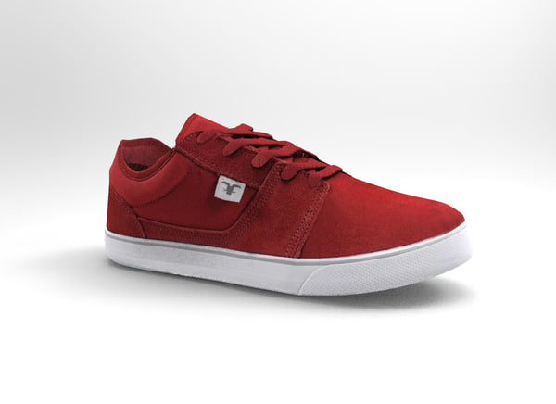

Approach - Architecture
Flow Map
UV Texture Map
UNet
Mesh
Shape Decoder
Vertices
Neural Network
Differentiable Renderer

Slide 11
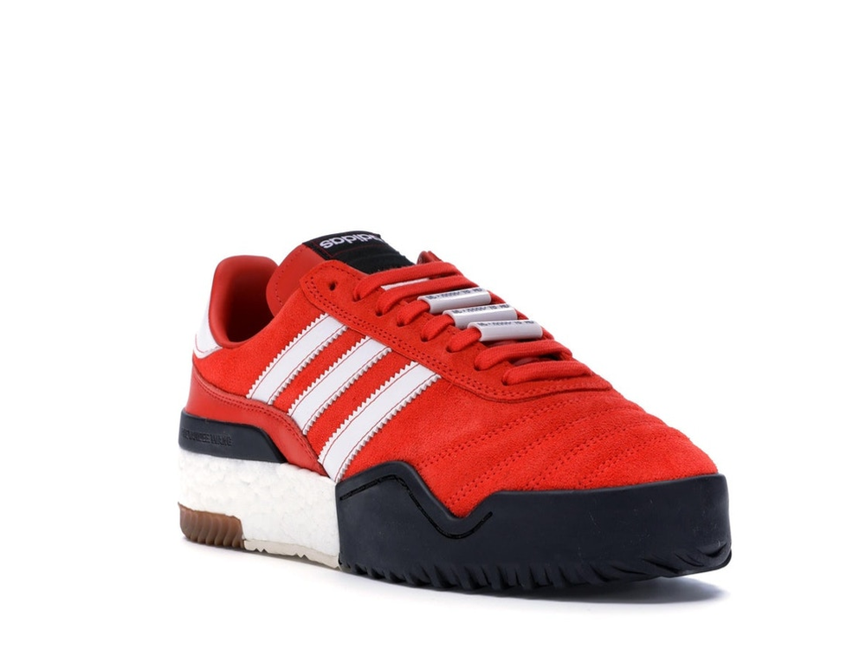
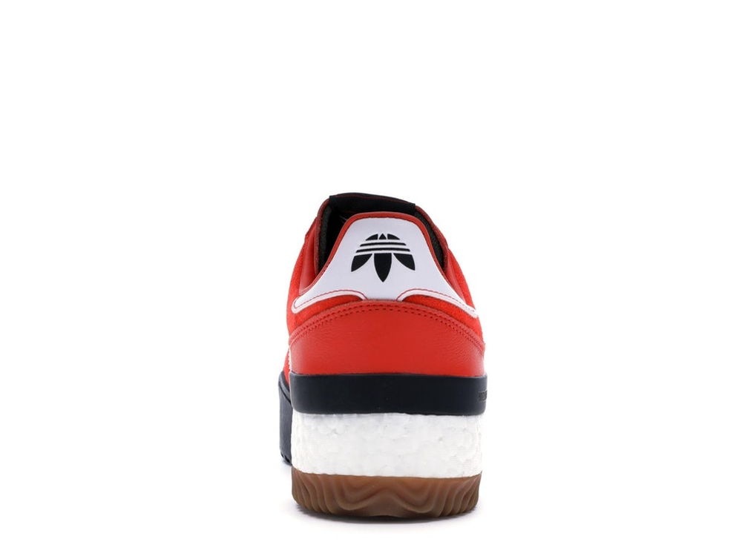
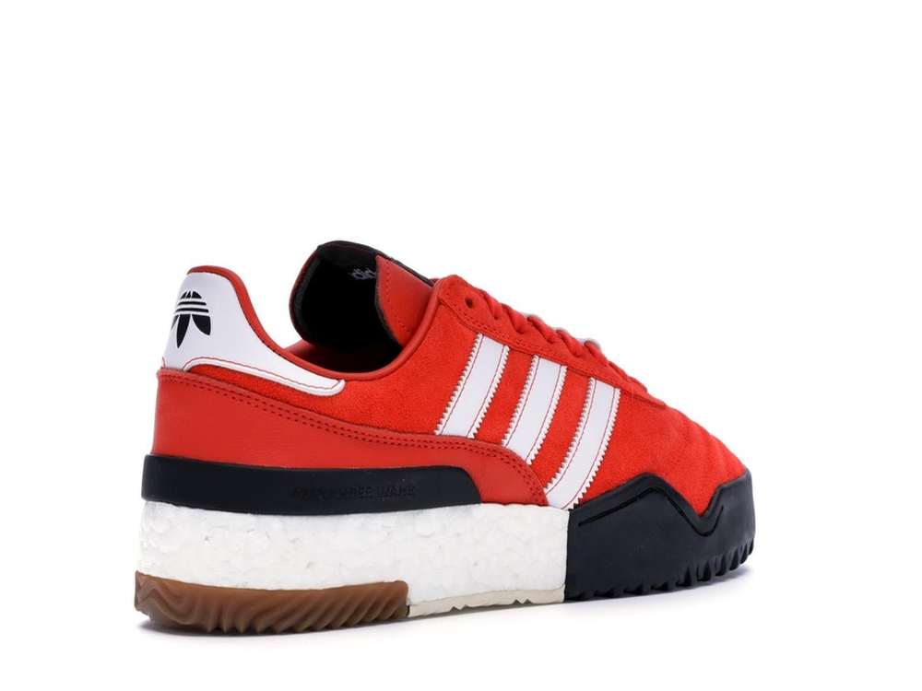
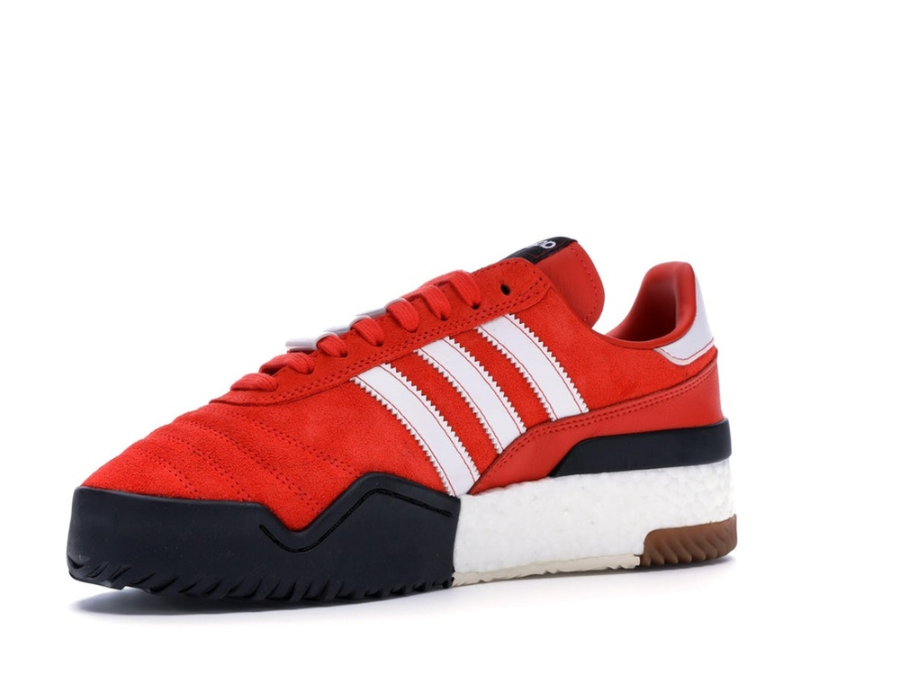
Approach - Loss
Mask IOU Loss
Image L2 Loss
Flow Loss
Flow Map
UV Texture Map
UNet
Mesh
Mesh Regularizers
Shape Decoder
Perceptual Loss
Vertices
Neural Network
Differentiable Renderer

Slide 12
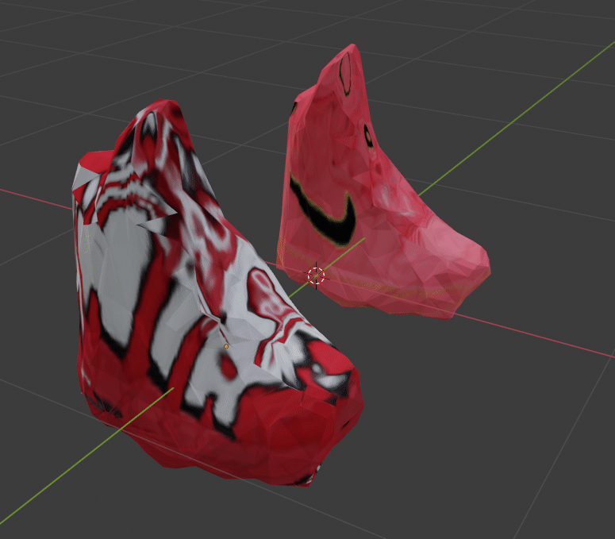
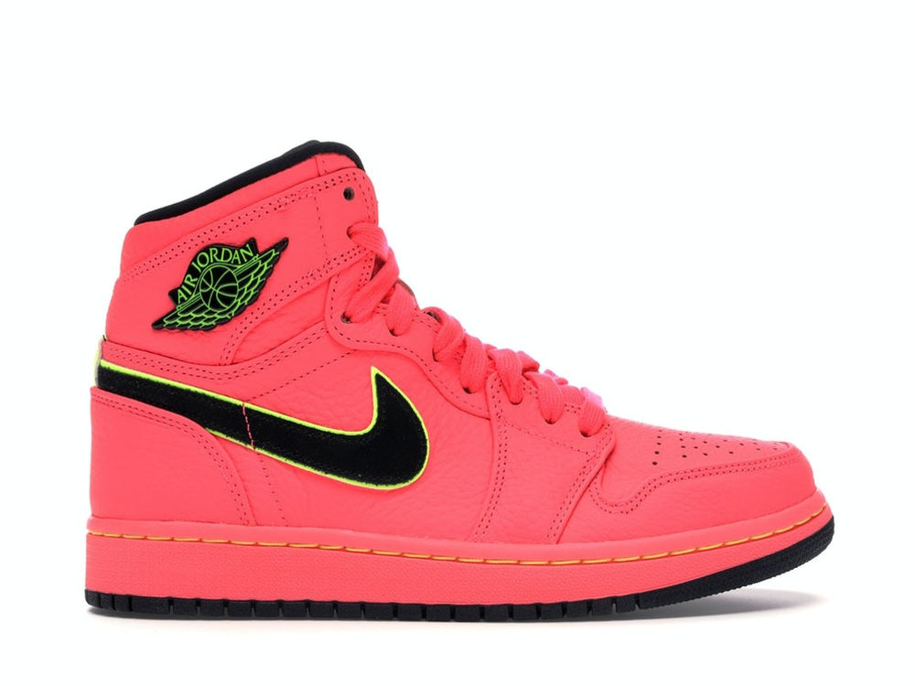
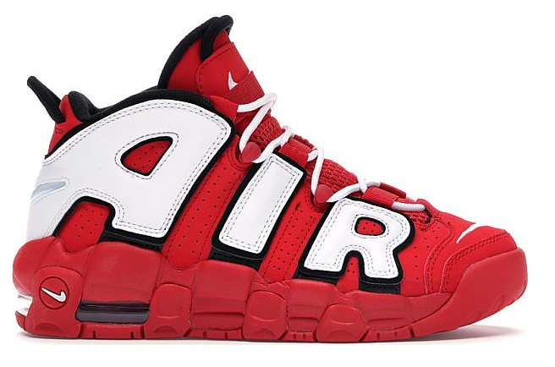
Results

Slide 13
Results
WEB DEMO

Slide 14
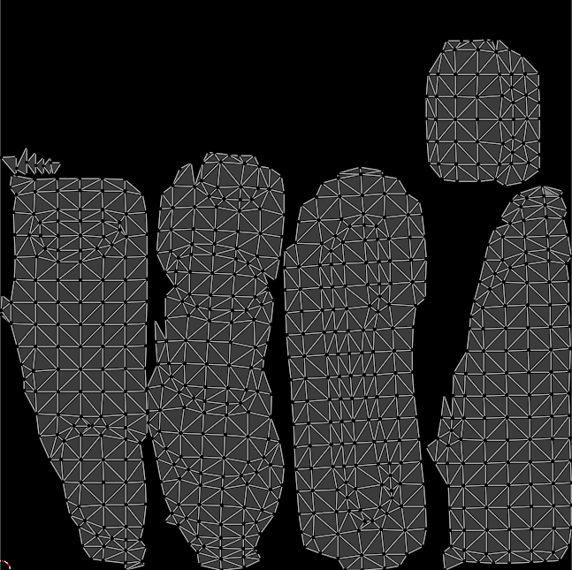
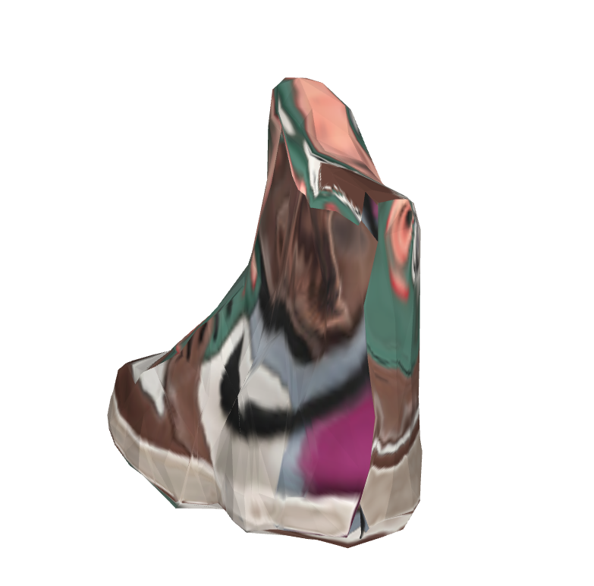
Issues - UV Map
Disconnected in UV Map
Causes poor texture flow

Slide 15
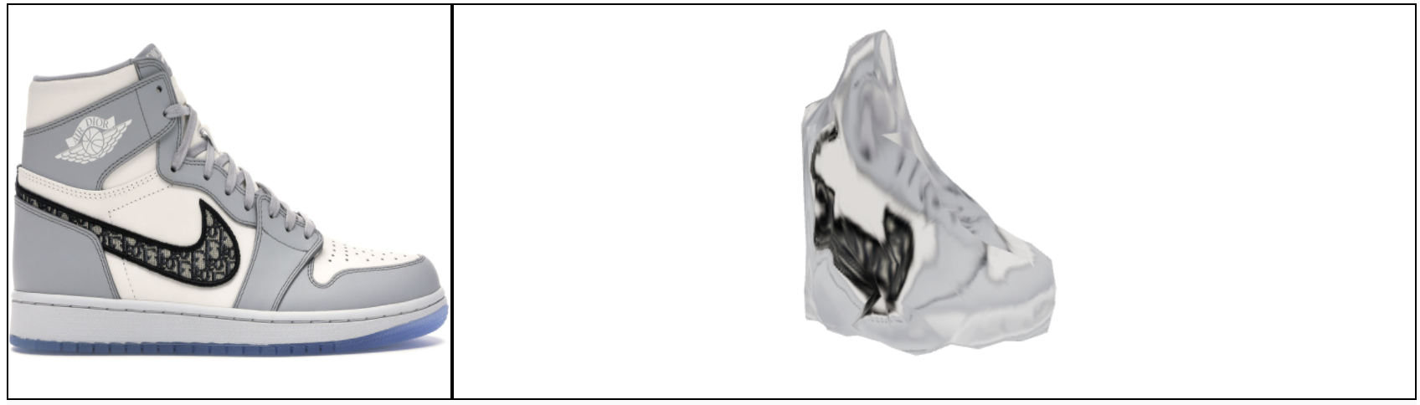
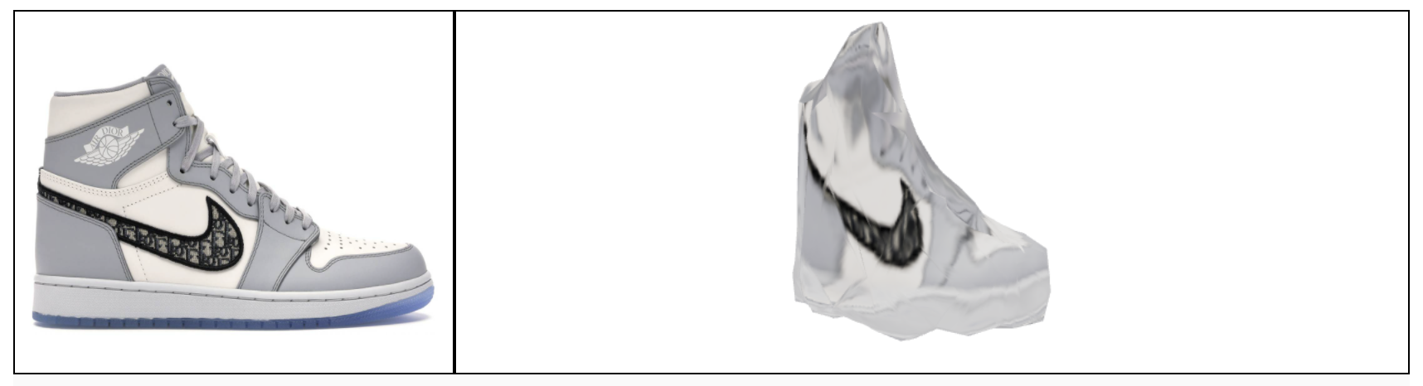
Issues - Invariance

Slide 16
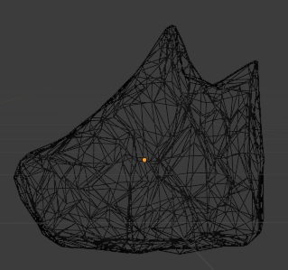
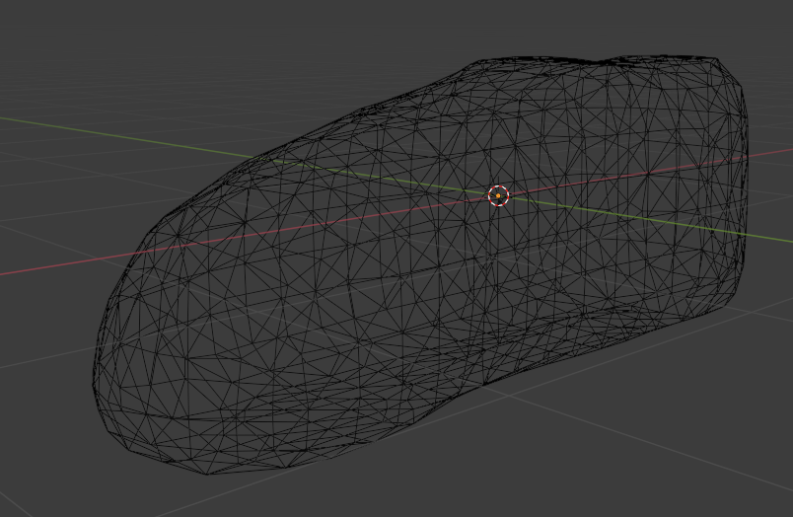
Issues - Imperfect Geometry

Slide 17
Conclusion
Works really well as proof of concept
Can be easily improved in to a commercial product - issues are fixable
Was a fun project

Slide 18
Supplementary Slides

Slide 19
Shape Decoder
Offset
Layer
Center
Fully Connected Network
Bias
Layer
UNET
Features
Center
Scale
Layer
Factor
Factor

